Slide 1
Wind Turbine Failure Detection
Project 1 - Post Graduate Program in Artificial Intelligence and Machine Learning: Business Applications
08/25/26

Slide 2
Contents / Agenda
Executive Summary
Business Problem Overview and Solution Approach
EDA Results
Data Preprocessing
Model Performance Summary
Appendix

Slide 3
Executive Summary
Actionable Insights
  The failures in the dataset occuring later in the dataset so when we organize the data for training, validation, and testing we have a chance of overfitting and the traning going to well beucase it will rarely if ever fail. We will be sure to not to rely on accuracy as this is not a good metric for success in this project. Our primary focurs will be recall because missig a failure is detrimental and expenive and precision as well.
Recommendations
  Aeolus Renewables should keep their schedule for monitoring issues around the clock through their SCADA system. But they need to change the way that they review info. In our most efficient model (XGBoost) is had a recall value of 85% meaning of the actual failures it missed 15% of them. The XGBoost model will be good for fault detection but according to the Precision value of 57.7% means that a little under half of the positives are actually false positives

Slide 4
Business Problem Overview and Solution Approach
Business Problem
  Aeoulous Renewables is an independent power producer operating a fleet of turbines. The company sells the electricity its turbines produce through long term power purchase agreements. The meaning issue is failure recognition, the O&M organization that monitors the fleet of turbines around the clock are reacting to major faults as opposed to repairing it before the damage is classified as catastrophic. Catastrophic failures are not only expensive to repair but the more time a turbine is down is less the energy that Aeoulous Renewables is able to sell off.
Solution Approach
  Build machine learning models and evaluate which model has the best performance so that it can act as drivetrain condition classifier that read each turbine feature and label it as “fault” or “normal”.
  The condition classifier will allow the fleet to distinguish a fault driven drivetrain versus a normal operating noise. Thus, allowing the fleet to catch faults while they are present but not yet severe enough to trigger a catastrophic alarm.

Slide 5
EDA Results
Failure bivariate analysis
  Fault frequency increases later in the observed period. This supports splitting the data chronologically into training, validation, and testing sets to evaluate how well the model performs on later observations. (Figure 1)
drivetrain_vibration_rms_mmps vs failure bivariate analysis
  Power output rises with wind speed, then plateaus and drops sharply at very high speeds. This pattern suggests that turbines limit output or shut down to protect components from excessive mechanical stress. (Figure 2)
wind_speed_mps vs power_output_kW bivariate analysis
  Power output rises with wind speed, then plateaus and drops sharply at very high speeds. This pattern suggests that turbines limit output or shut down to protect components from excessive mechanical stress. (Figure 3)
Link to Appendix slide on data background check

Slide 6
EDA Results
Air_density_kgm3 univariate analysis
  The histogram for this bivariate analysis is “bimodal” meaning that it has two peaks. The two peaks may suggest that there are two optimal air density conditions for the wind turbines (Figure 4)
Drivetrain_vibration_rms_mmps univariate analysis
  The model is right skewed, this is an indication that higher vibration are less frequent but can lead to future failure in the dataset as vibration can cause the gears and generator to take on damage as time passes. (Figure 5)
Numeric features multivariate analysis
  The model filters the dataset and only request numeric features. I created a correlation matrix to anylze the degree of similarity for all of my features. I found that rotor speed and generator speed have the highest correlation, this tracks because the two features fall under “Operational Control & State”. (Figure 6)
Link to Appendix slide on data background check

Slide 7
Data Preprocessing
Duplicate Value Check
  During my obersation during my duplicates check there we no duplicates present in the dataset.
  The method utilized to check for duplicates was to gather the sum using the function below
    data.duplicated().sum()
    The result was 0, confirming no duplicate rows were present in the dataset.
Missing Value Detection and Treatment
  While searching for missing values I first identifed the columns that had missng values using the code below
    missing_summary = pd.DataFrame({"Missing Values": data.isna().sum()})
    When the code executed, I noticed that the “gearbox_oit_temp_C”, “gearbox_bearing_temp_C, and the “enerator_bearing_temp_C” all had a significant amount of missing values throughout the dataset.
    Replaced missing values with the training-data median because it is less affected by extreme readings than the mean.

Slide 8
Data Preprocessing
Feature Engineering
  I extracted the the hour of day and the day of the week from the “timestamp” column.
  The purpose of this is so the model can learn complex patterns across the timestamp feature.
Data Preparation for Modeling
  Separated input features from the target variable, which is “failure”.
  Split data chronologically into 70% training, 15% validation, and 15% testing.
  Filled missing values using training-set medians.
  Excluded timestamp, turbine ID, and wind-speed bins from model inputs.

Slide 9
Model Performance Summary and Final Model Selection
Performance of the tuned models
  XGBoost
    Baseline validation: 48.7% recall; 78.6% precision
    Tuned validation: 90.8% recall; 60.9% precision
    Tuning substantially increased fault detection, with a higher proportion of false alerts.
  Artificial Neural Network (ANN)
    Baseline validation: 61%% recall; 73.4% precision
    Tuned validation: 60.4% recall; 81.8% precision
    Tuning improved precision but had a slight decrease in recall.
  Decision Tree
    Baseline validation: 19.1% recall; 83.5% precision
    Tuned validation: 75.6% recall; 40.6% precision
    Tuning substantially increased fault detection, but more than half of flagged observations were false alerts.

Slide 10
Model Performance Summary and Final Model Selection
  Random Forest
    Baseline validation: 2.5% recall; 74.3% precision
    Tuned validation: 65.3% recall; 74.8% precision
    Tuning substantially improved fault detection while maintaining similar alert precision.
  Gradient Boosting
    Baseline validation: 33.4% recall; 48.5% precision
    Tuned validation: 47.1% recall; 79.4% precision
    Tuning improved both fault detection and alert precision, although more than half of fault observations remained undetected.
Overview of final model and its parameters
  Tuned XGBoost
    Combines decision trees to classify drivetrain observations as fault or normal.
    Tuned through randomized search with five-fold cross-validation, prioritizing recall.
    Tree settings: 100 trees, maximum depth of 3, and learning rate of 0.05.

Slide 11
Model Performance Summary and Final Model Selection
Comment on the performance of the final model
  Performance of the Final Tuned XGBoost Model
    Achieved 90.8% validation recall and 60.9% validation precision.
    Detected approximately 91% of fault observations, while approximately 39% of flagged observations were false alerts.
    Achieved the highest validation recall and F1 score (72.9%) among all evaluated models.
    Best aligned with the project’s priority of minimizing missed faults.

Slide 12
APPENDIX

Slide 13
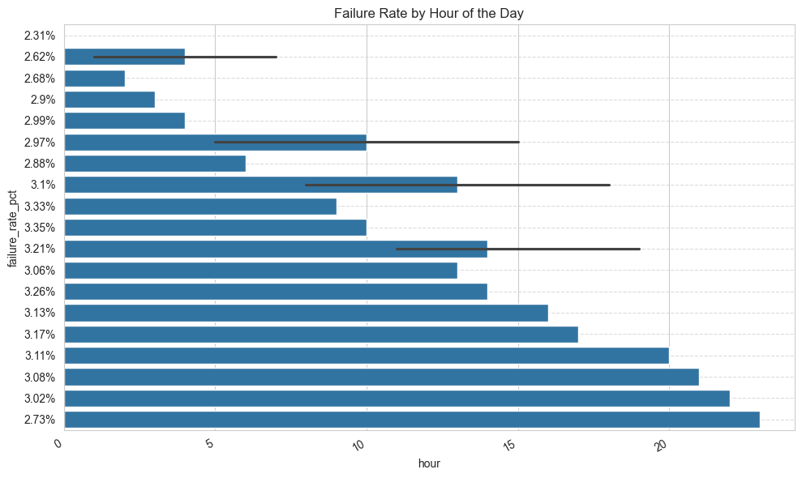
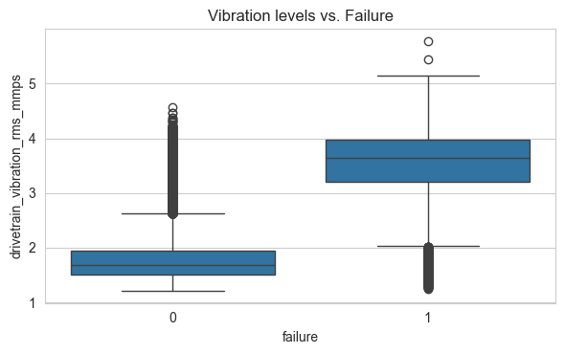
Data Background and Contents
Please mention the data background and contents
Figure 1
Figure 2

Slide 14
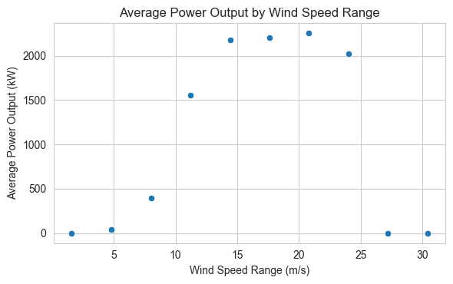
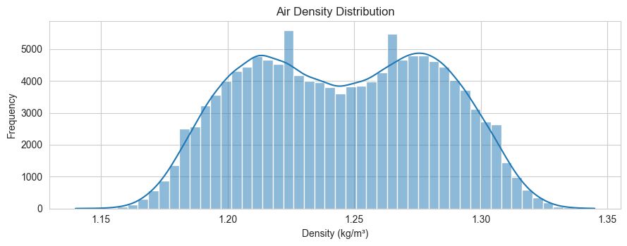
Data Background and Contents
Please mention the data background and contents
Figure 3
Figure 4

Slide 15
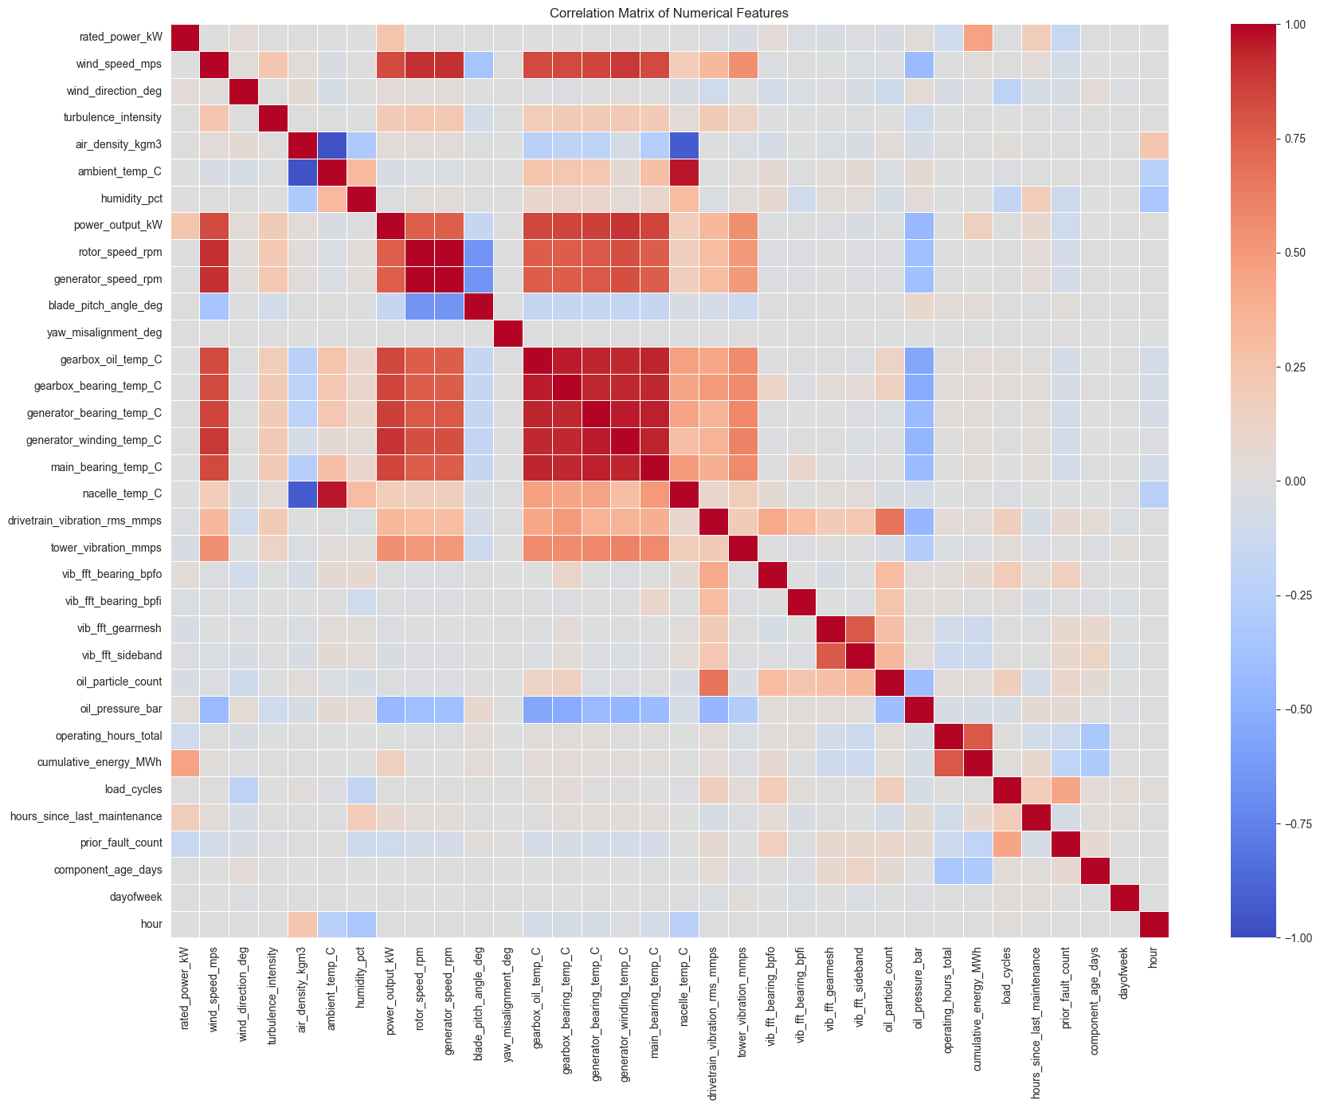
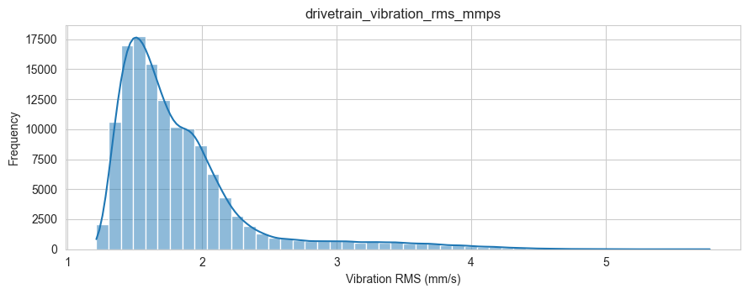
Data Background and Contents
Please mention the data background and contents
Figure 5
Figure 6

Slide 16
Model Improvement – Baseline
Baseline Models — Validation Performance Scores
  Decision Tree: Accuracy 95.5% | Recall 19.1% | Precision 83.5% | F1 31.0%
  Random Forest: Accuracy 94.8% | Recall 2.5% | Precision 74.3% | F1 4.8%
  Gradient Boosting: Accuracy 94.6% | Recall 33.4% | Precision 48.5% | F1 39.6%
  XGBoost: Accuracy 96.6% | Recall 48.7% | Precision 78.6% | F1 60.1%
  ANN: Accuracy 96.4% | Recall 58.1% | Precision 68.8% | F1 63.0%

Slide 17
Model Building - Baseline
Comments of the baseline models performance
  Decision Tree: The decision tree is not optimal for the task at hand due its recall score of 19.1%, this shows that we miss 80% of the failures in the dataset which is unacceptable.
  Gradient Boosting: A slight increase to the recall score with a score of 33.4% but that still put the model at missing of 50% of the failures in the model which is unacceptable.
  Random Forest: The lowest recall score of 2.5%, this model cannot be utilized in anyway for accurate “failure”/”normal” classification.
  XGBoost: A large increase to recall score compared to the others with a score of 48.7% which is getting my closer to my desired minimum classifying 50% of the faults in the model correctly.
  ANN: The largest recall score of 58.1%, this puts me in my desired range for a recall score making this the optimal baseline model.

Slide 18
Model Improvement - Hyperparameter Tuning
The best performing models with rationale

Slide 19
Model Improvement - Hyperparameter Tuning
Describe the method used and parameters tuned
  Artificial Neural Network (ANN)
    Used manual tuning to compare different configurations.
    Adjusted the number of neurons in both hidden layers, training epochs, and batch size.
    Compared validation recall and precision, prioritizing recall while monitoring false alerts.
  XGBoost
    Used randomized search to evaluate 30 hyperparameter combinations with five-fold cross-validation.
    Tuned the number of trees, learning rate, tree depth, minimum child weight, gamma, row and feature sampling, and L1/L2 regularization.
    Selected the configuration with the highest average cross-validation recall, then evaluated its validation recall and precision.

Slide 20
Model Improvement - Hyperparameter Tuning
Comment on the performance of the tuned models
    ANN (Artificial Neural Network)
      Tuning increased the validation recall score from 60.3% to 66.1% and the precision went from 71.5% to 79.5%.
      The model improved in fault detection and alert precision.
    XGBoost
      Tuning increased the validation recall score from 48.7% to 90.8% and the precision decreased from 78.6% to 60.9%.
      This reflects a stronger fault detection despite larger faults alerts
      XGBoost remains the optimal model due to recall being the primary focus due to missed failures resulting in costly repairs and a negative effect on profit.

